Slide 1
Data Modeling

Slide 2
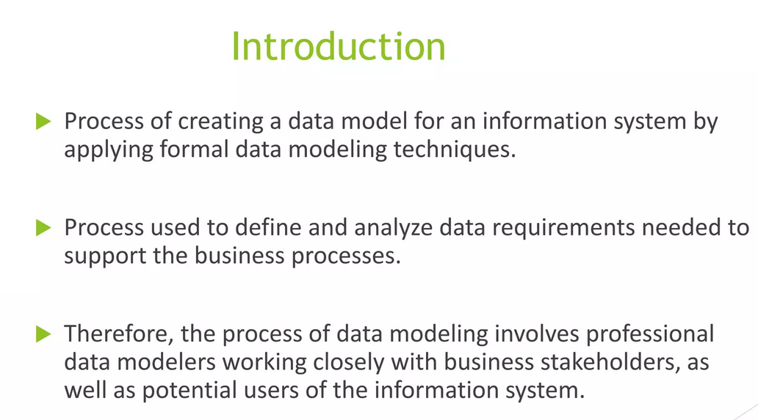

Slide 3
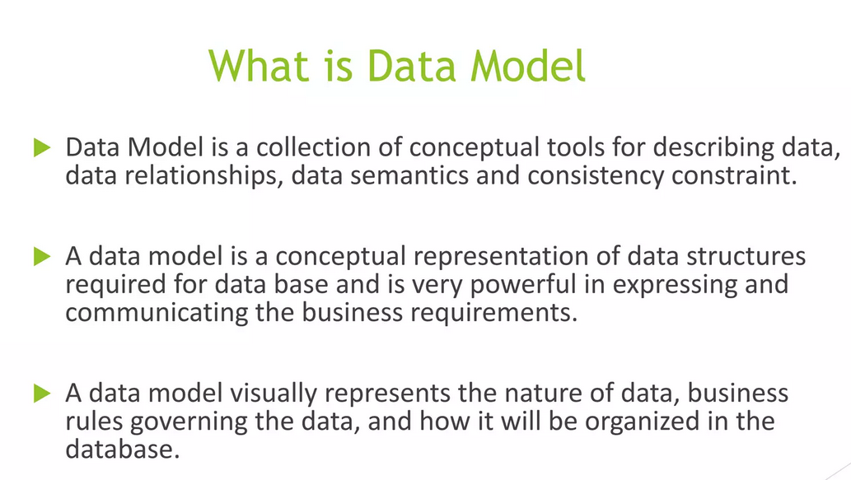

Slide 4
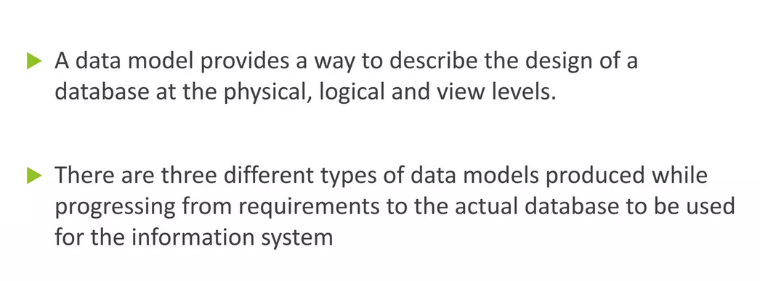

Slide 5
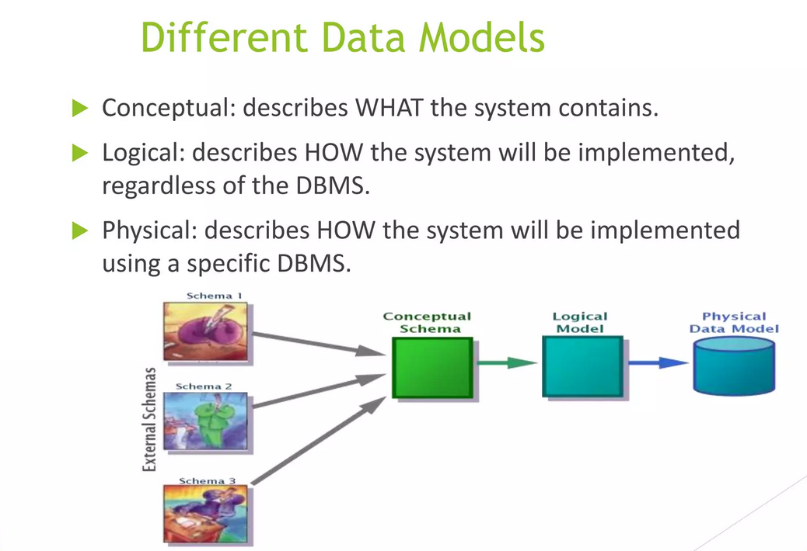

Slide 6
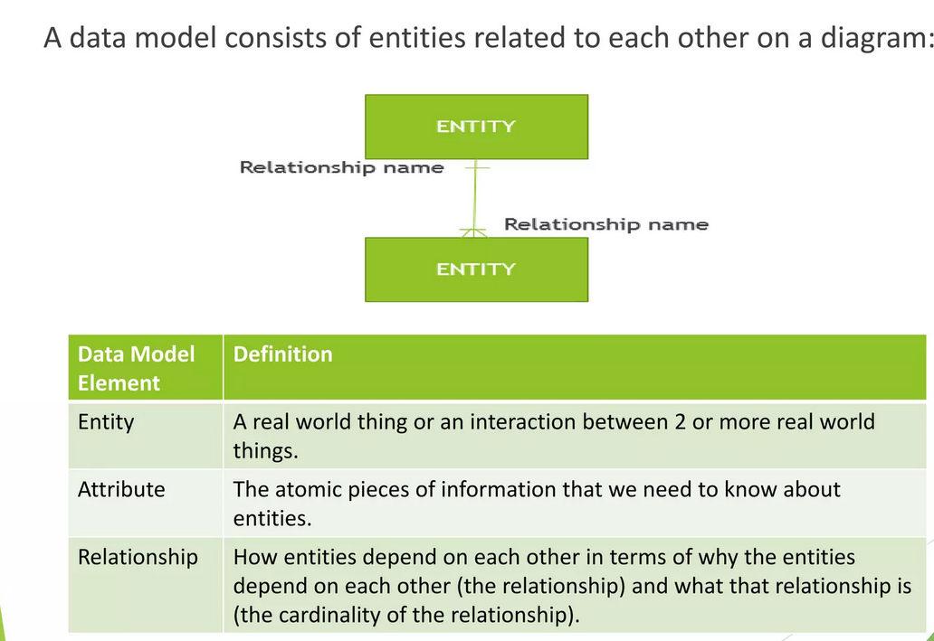

Slide 7
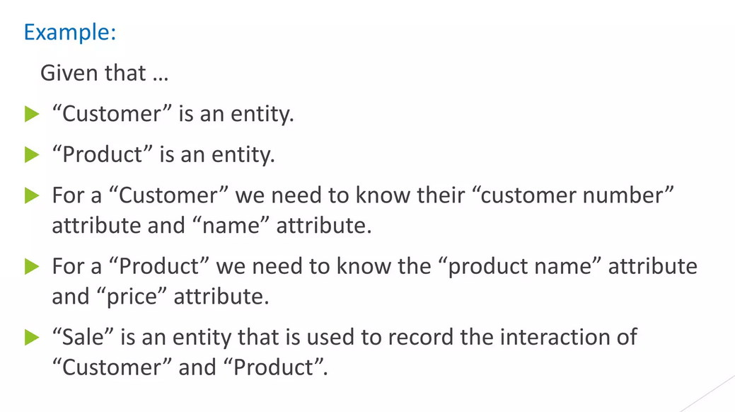

Slide 8
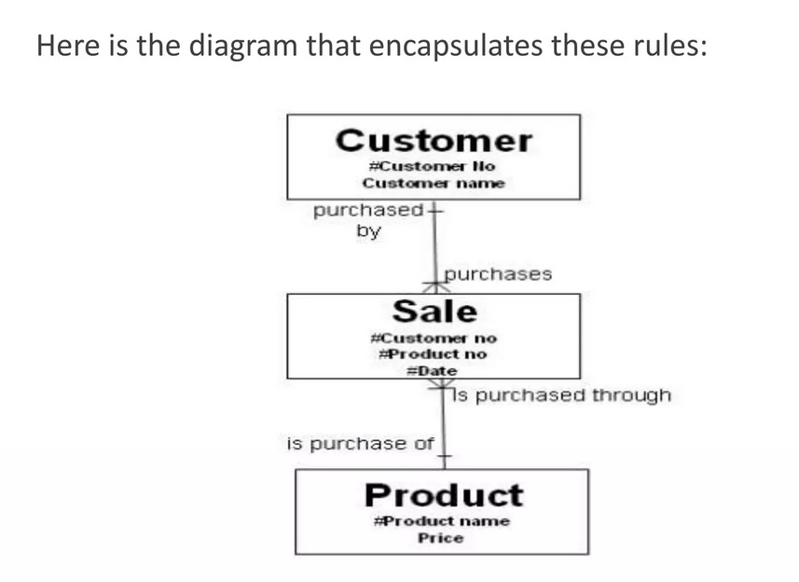

Slide 9
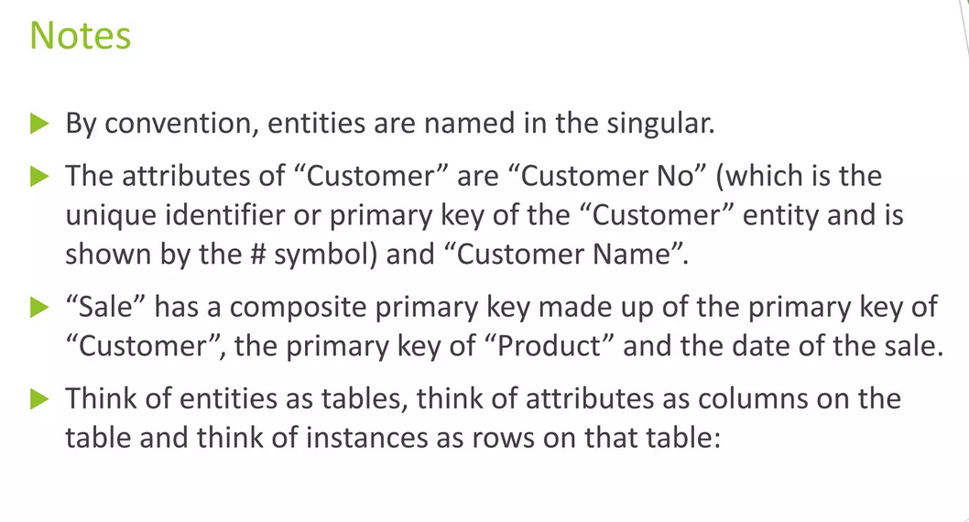

Slide 10
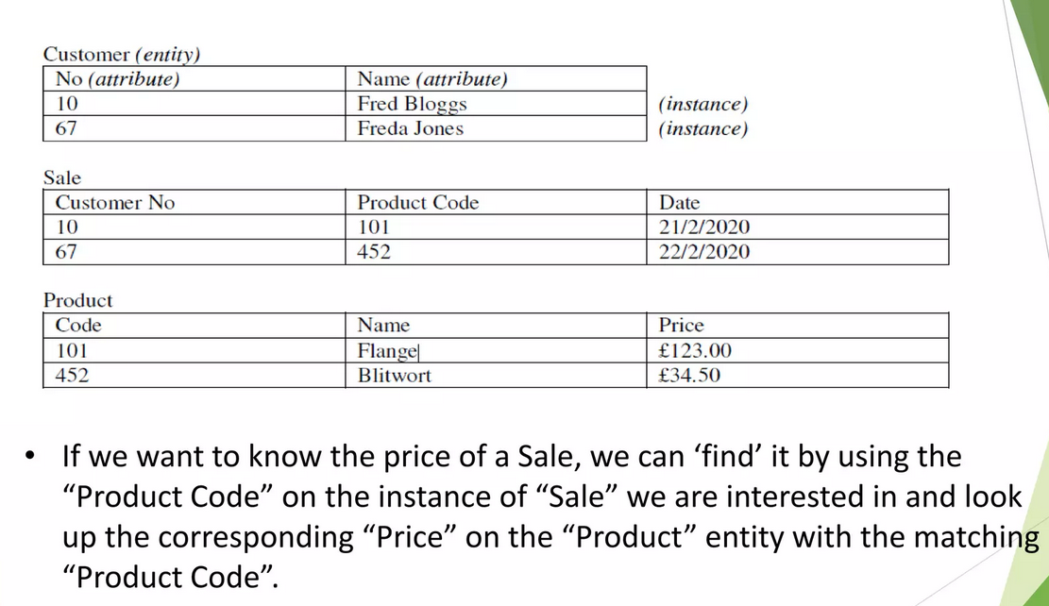

Slide 11
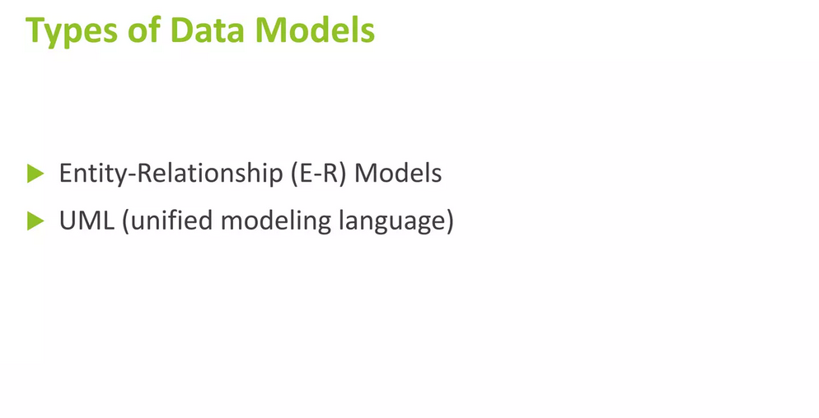

Slide 12
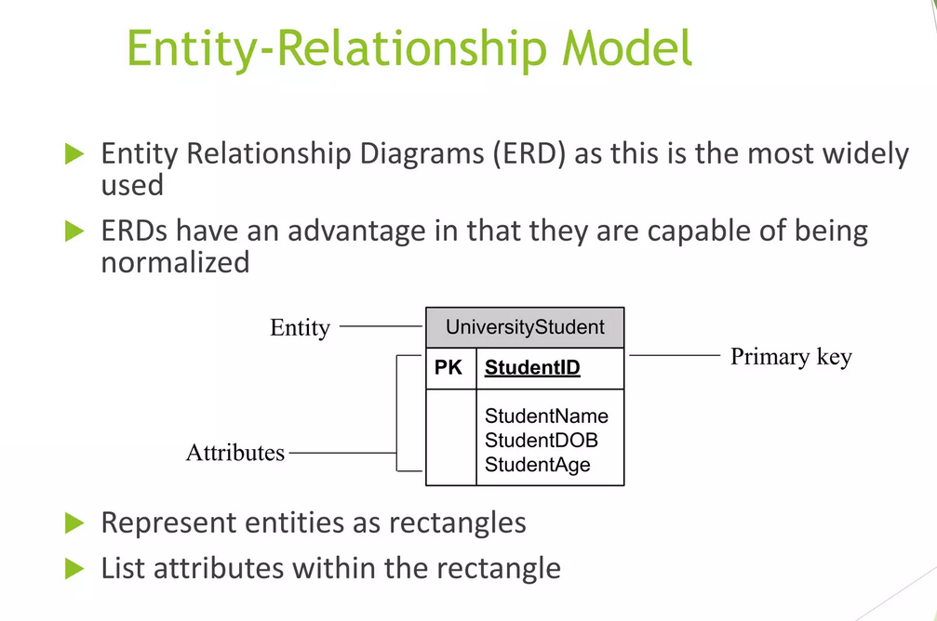

Slide 13
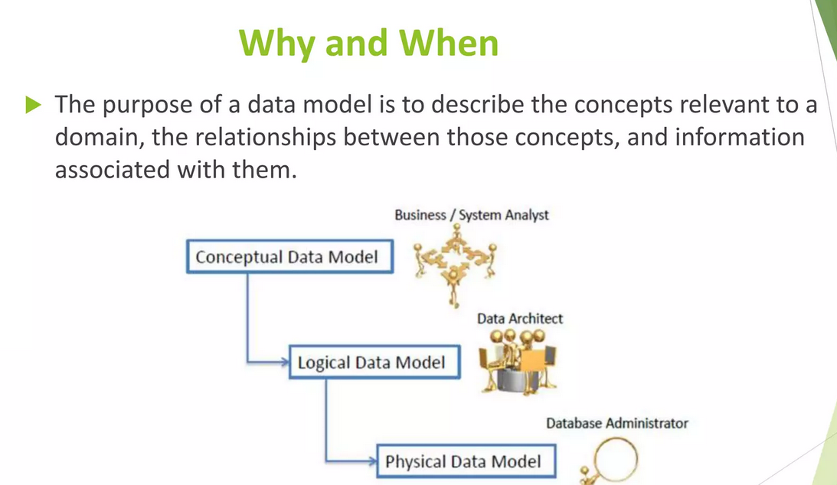

Slide 14
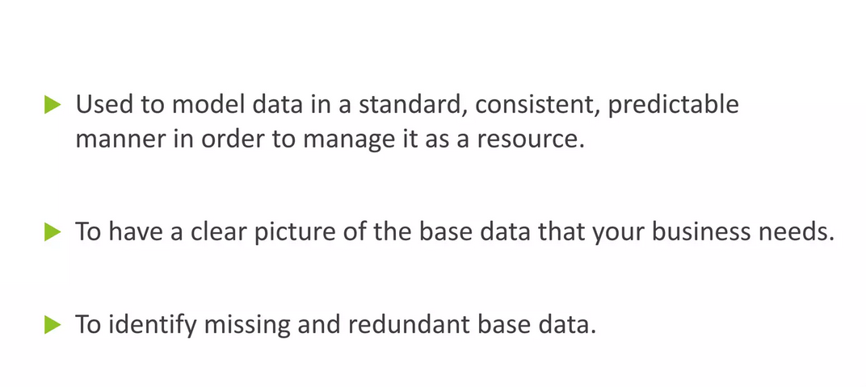

Slide 15
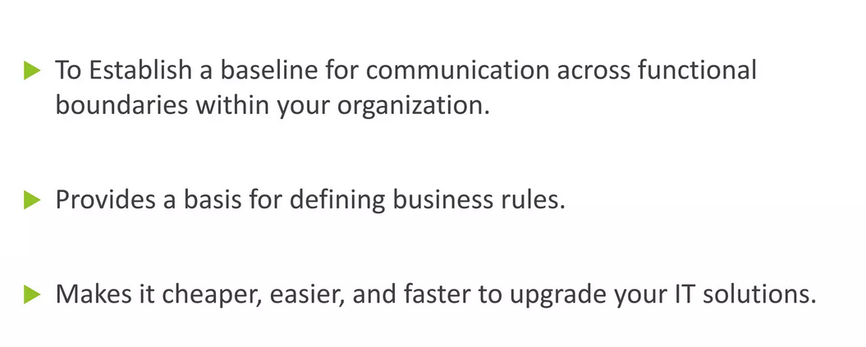

Slide 16
Types of Database System

Slide 17
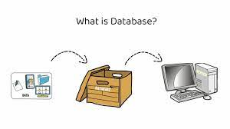
What is Database ?
A database is a collection of data that is organized and stored in a structured format, allowing for easy access, manipulation, and analysis of the data. Databases can be used to store a wide variety of data, including financial records, customer information, inventory records, and more.

Slide 18
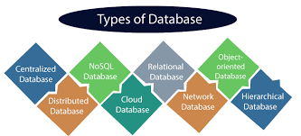

Slide 19
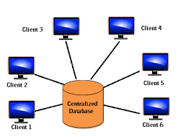
1.Centralized database
A database is a collection of data that is organized and stored in a structured format, allowing for easy access, manipulation, and analysis of the data.
Databases can be used to store a wide variety of data, including financial records, customer information, inventory records, and more.
Ex:- CPU Server, Desktop

Slide 20
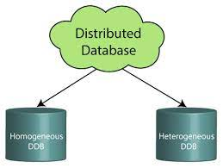
2.Distributed database
A distributed database system is a type of database management system that stores data across multiple computers or sites that are connected by a network.
In a distributed database system, each site has its own database, and the databases are connected to each other to form a single, integrated system.
Ex:- Netflix, Apache Ignite, Apache Cassandra

Slide 21
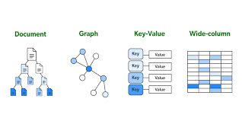
3. NoSQL Database
NoSQL databases use a variety of data models for accessing and managing data.
These types of databases are optimized specifically for applications that require large data volume, low latency, and flexible data models, which are achieved by relaxing some of the data consistency restrictions of other databases.
Ex:- MongoDB, CouchDB, CouchBase

Slide 22
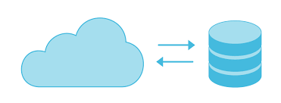
4.Cloud Database
A cloud database is a database built to run in a public or hybrid cloud environment to help organize, store, and manage data within an organization.
Cloud databases can be offered as a managed database-as-a-service (DBaaS) or deployed on a cloud-based virtual machine (VM) and self-managed by an in-house IT team.
Ex:- Gmail ,YouTube, Google Drive

Slide 23
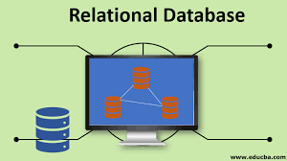
5.Relational Database
A relational database is a type of database that stores and provides access to data points that are related to one another.
Relational databases are based on the relational model, an intuitive, straightforward way of representing data in tables.
Ex:- Oracle Database, MySQL , IBM DB2.

Slide 24
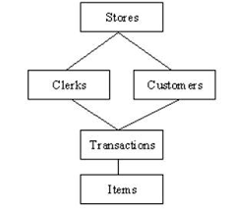
6.Network Database
A network database is based on a traditional hierarchical database, except it allows each object to have multiple parents instead of a single parent.
This allows you to model more complex relationships. Network databases can be represented as a graph instead of a tree structure.
Ex:-TurboIMAGE ,
Integrated Data Store (IDS),
Raima Database Manager,
Univac DMS-1100

Slide 25
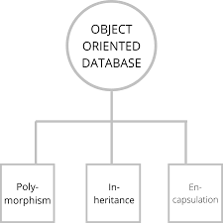
7.Object Oriented Database
a database system that can work with complex data objects — that is, objects that mirror those used in object-oriented programming languages.
In object-oriented programming (OOP), everything is an object.
Ex:- PostgreSQL

Slide 26
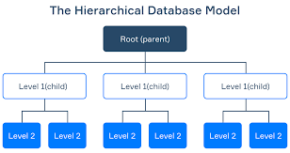
8.Herarchical Database
A hierarchical database model is a data model in which the data are organized into a tree-like structure.
The data are stored as records which are connected to one another through links.
A record is a collection of fields, with each field containing only one value.
Ex:- Information Management System (IMS) by IBM,
NOMAD by NCSS

Slide 27
Thank You

